Slide 1
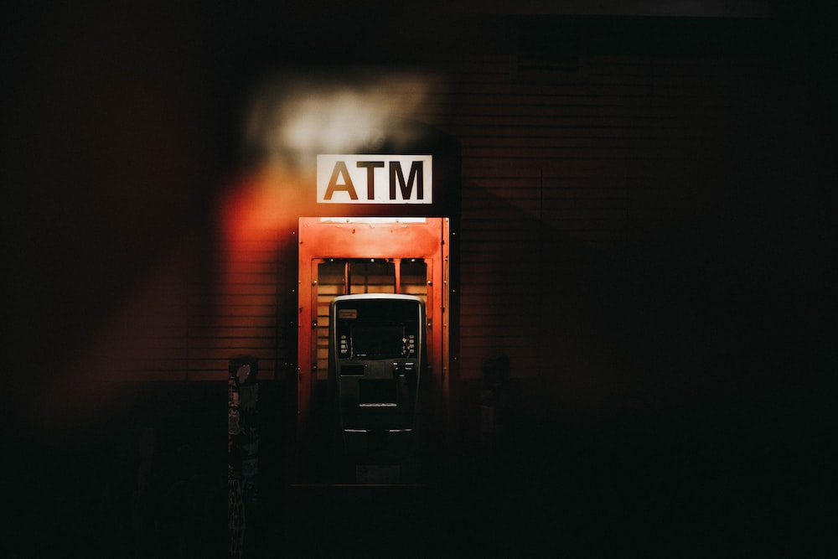
AUTOMATED
TELLER
MACHINE(ATM)

Slide 2
OUTLINE:
INTRODUCTION
ATM CARD
ADVANTAGES OF ATM
FUNCTIONS OF ATM
ACCOUNT BALANCE
WITHDRAW
CASH DEPOSIT
PIN CHANGE
CONCLUSION

Slide 3
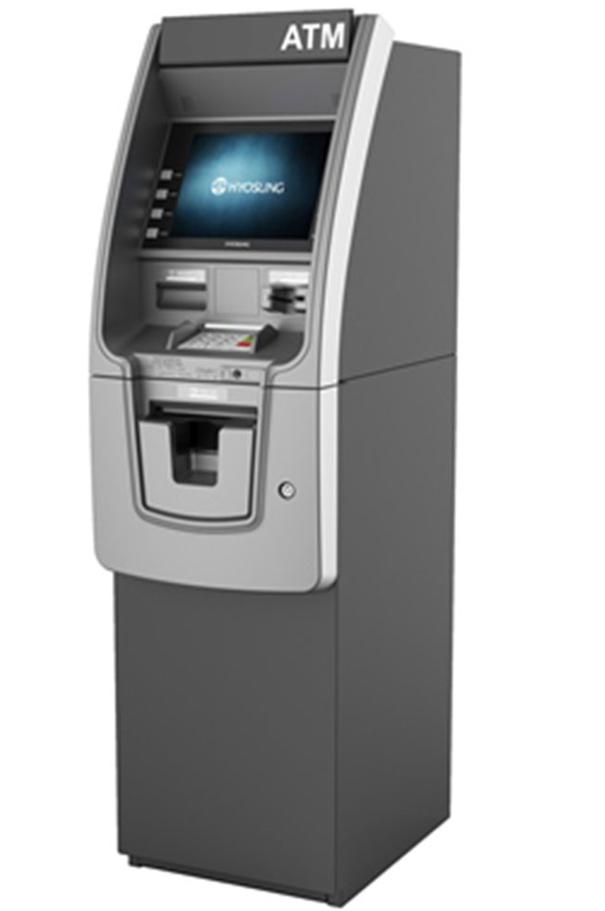
INTRODUCTION
This is where an Automated Teller Machine or an ATM comes into play. You must already be pretty familiar with the term
ATM as it has sort of become a necessity to carry out day-to-day transactions in an easy and convenient way.
You don't need to go to the bank or wait for your turn to interact with the teller for such minimum transactions. This saves a lot of your precious time and also proves to be of great use in emergencies and time of need.

Slide 4
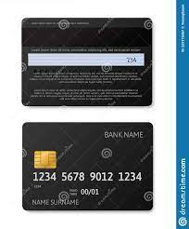


ATM CARD
It is a plastic ATM card with a magnetic strip.
THIS CARD ISSUED BY BANK.
It contains a unique card number and identity information
It is also known as cash cards, bank card, client card,key card.

Slide 5
Advantages of ATM
Convenience to customers
Offers 24x7 Service
Reduce bank work load
Travel without cash
Provides privacy in banking transactions
Good quality currency notes
You don’t need to fill out withdrawal and deposit slips as is required at the bank

Slide 6
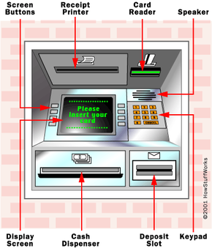
FUNCTIONS OF ATM:
View Account Balances & Mini-statements
24-hour access to cash/withdrawal
Deposit cash
Pin change
Easy access

Slide 7
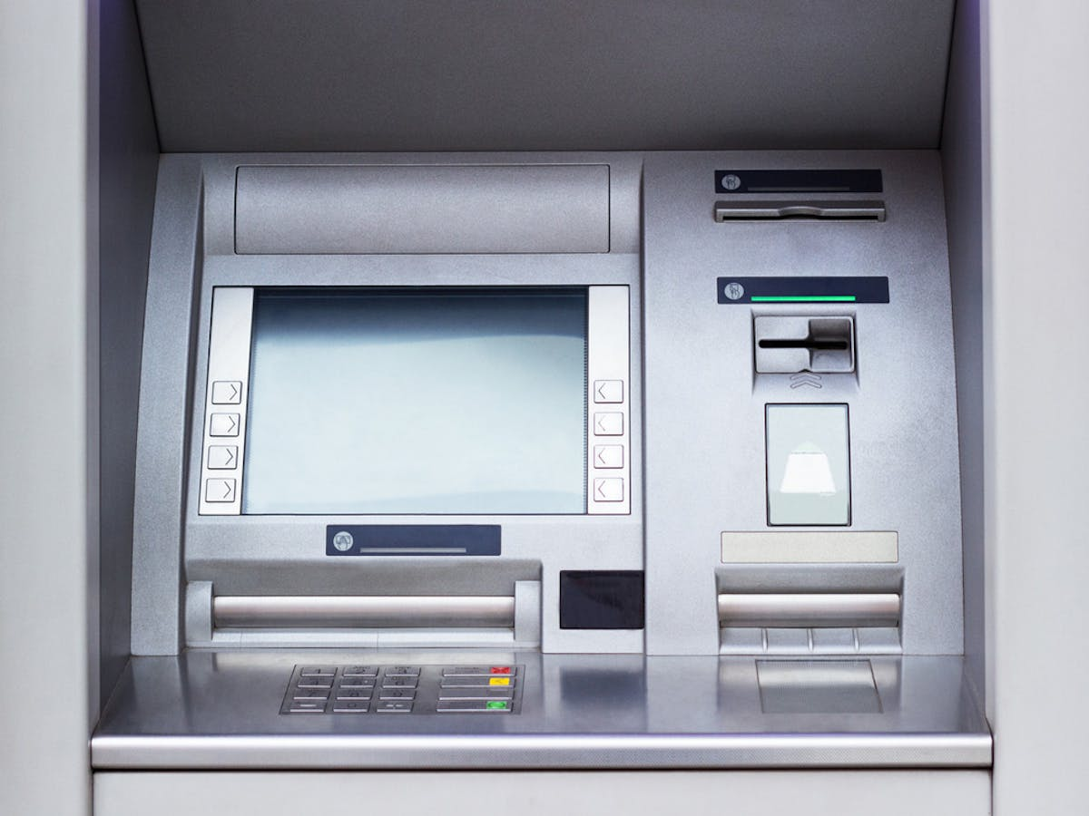
VIEW ACCOUNT BALANCES & MINI-STATEMENTS
A summary of finical which have occurred over a given period on bank account held by a person or business with financial institution a printed record of the balance in a bank account and the amounts that have been paid into it and withdrawn from it, issued periodically to the holder of the account.

Slide 8
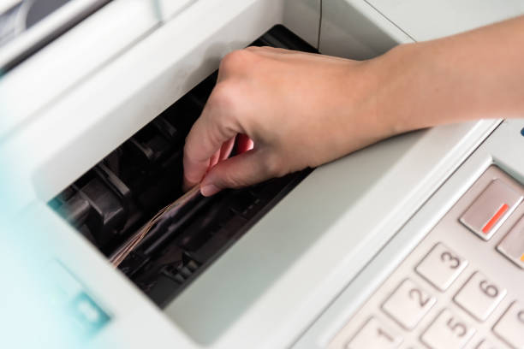
24-HOUR ACCESS TO CASH/ WITHDRAWAL
Step 1 - Insert your ATM card in the slot in the ATM machine.
Step 2 - Enter your 4-digit confidential ATM PIN.
Step 3 - Select the type of transaction you wish to make, from the given options.
Step 4 – Confirm the withdrawal amount.

Slide 9
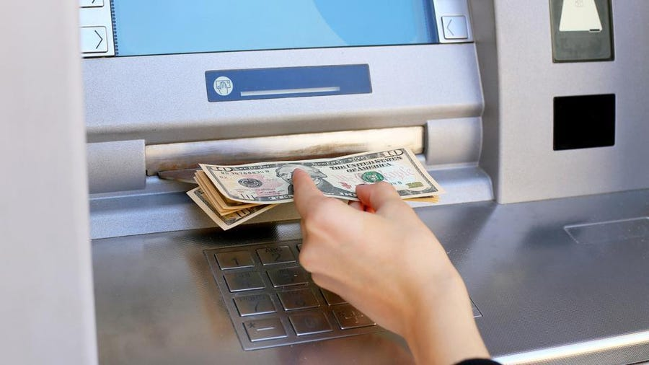
DEPOSIT CASH
Insert your ATM cum Debit Card in the Cash Deposit ATM and enter your PIN. Select from Current or Savings Account, click on the deposit money' option, and enter the deposit amount. Place your cash carefully in the cash deposit slot and click to continue.

Slide 10
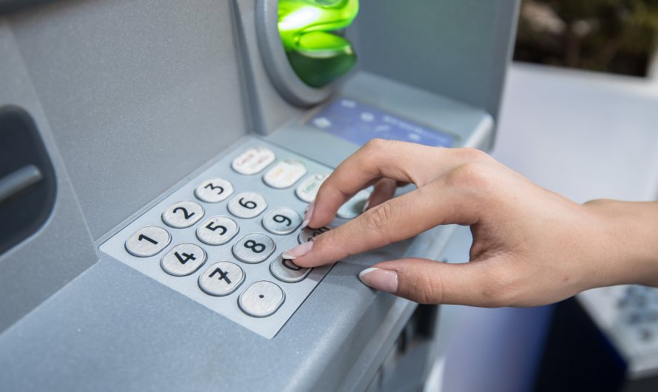
PIN CHANGE
Step 1 - Insert your ATM card in the slot in the ATM machine.
Step 2 - A customer will be required to enter ATM Old personal identification number (PIN).
Step 3 – customer is requested to enter the New PIN.
Step 4 – Confirm the New PIN.
Step 5 - Successfully PIN has been changed.

Slide 11
CONCLUSION
We Hereby conclude that atm is the easiest way of depositing and withdrawing money.Transaction is possible anytime,that’s why in india people call atm as
“ALL TIME MONEY”.
If ATM machines are connected to internet then it’s possible to do transaction from anywhere.
With the security of atm improving it has now became a safe mode of transaction.
Hence, it can be concluded that atm is safe, fast,reliable, convenient,excisable and any time money machine

Slide 12

Thank You.
GROUP MEMBERS:
L.Sanjana – AP21110010685
J.Yaswanth Sri Ram - AP21110010686
J.Prasanna Kumar – AP21110010687
P.Chakradhar – AP21110011223

